Slide 1



Industrial automation
Michiel Hamblok
Dennis Merken
Jason Vaesen
Bart Grispen
Abad Sethi

Slide 2
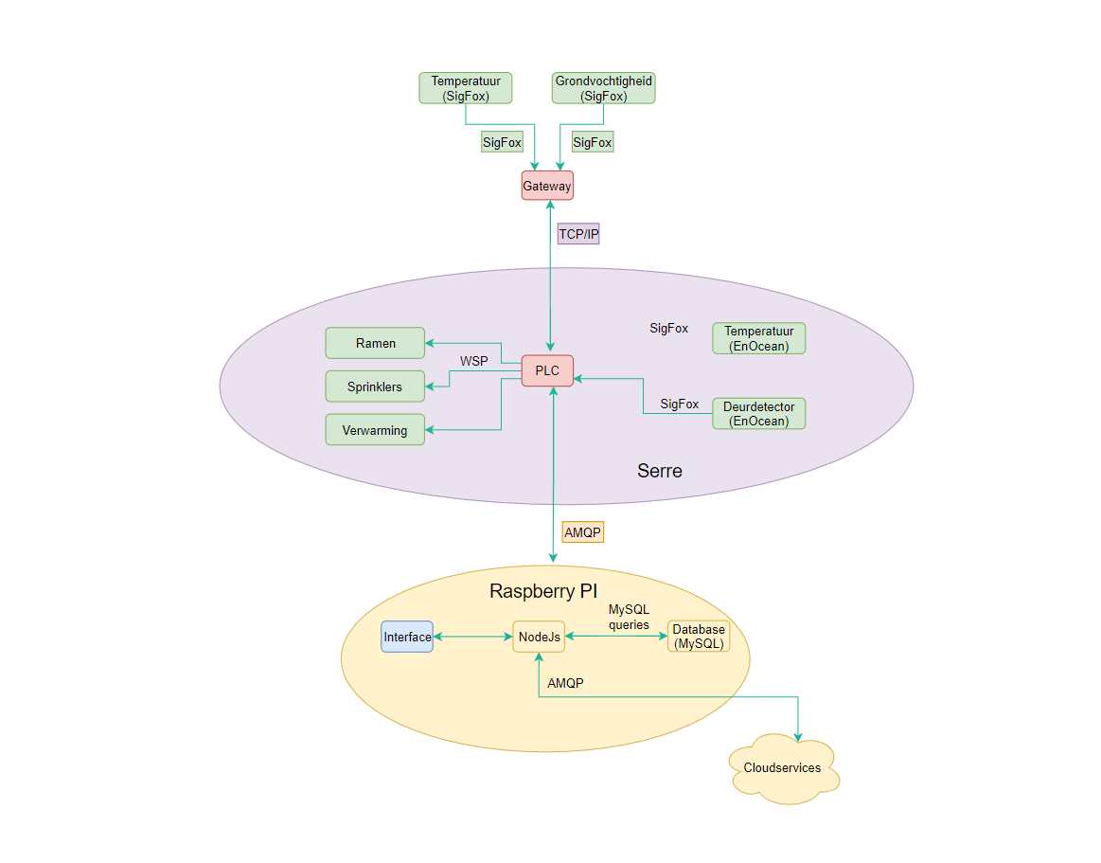
Inhoudsopgave
PLC
Sigfox
Database
2

Slide 3
PLC
IP 192.168.1.82 Set → Twincat Device manager
Assembly/Wiring
Testprogram
JSON Encode
3
PLC - SigFox - DataBase - Abad

Slide 4
Sigfox
Back-end activation pending
Sensor in Sigfox mode geconfigureerd
TwinCat
Decrypting payload in TC
4
PLC - SigFox - DataBase - Abad

Slide 5
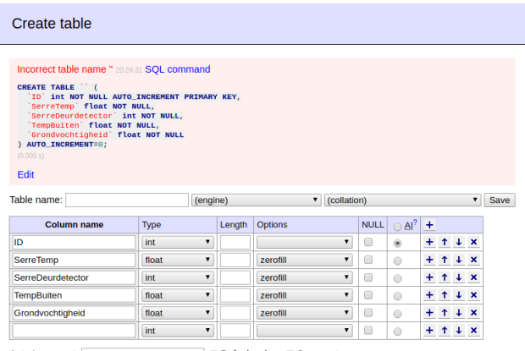
Database
Raspberry Pi
MySQL
Adminer 4.7.5 --> Apache2
TestDB:
Error
Geen rechten
5
PLC - SigFox - DataBase - Abad

Slide 6
Einde

